Slide 1
Lab 07-1: Interrupts

Slide 2
What is interrupt ?
An event that requires the CPU to stop normal process execute and performs some service.
Often indicate that an event has occurred that needs an urgent response.
Generated by hardware of software.
Occurs in response to an external event: e.g., Change in pin potential
Responding to software instructions: e.g., Call Interrupt in the program

Slide 3
What is interrupt ?
Before we have interrupts, the technique we used is:
Busy Waiting (Polling): A process repeatedly checks to see if a condition is true.
But now we use interrupts.
Their choices involve trade-offs.

Slide 4
Introduction to interrupt
Interrupt service routine (ISR)
main(){
while(true){
}
}
program
interrupt

Slide 5
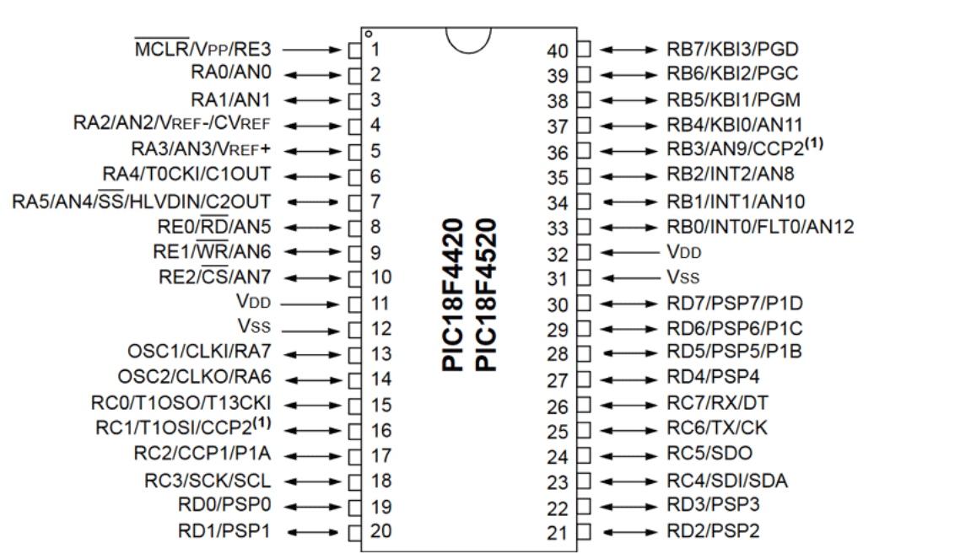
PIC18F4520 pinout

Slide 6
Interrupt in PIC18f4520
When an interrupt occurs, the process:
The global interrupt enable bit (GIE bit at INTCON<7>) is cleared to disable further interrupts
If Interrupt priority feature is enabled, high priority interrupt sources can interrupt a low priority interrupt. IPEN bit (RCON<7>)
The return address is pushed onto the stack and the PC is loaded with the interrupt vector address. (High-priority at 0x08, Low-priority at 0x18)
The interrupt flag bits must be cleared in software before re-enabling interrupts to avoid recursivbe interrupts.

Slide 7
Interrupt in PIC18f4520
The “return from interrupt” instruction, RETFIE, exits the interrupt routine and sets the GIE bit.
In general, interrupt sources have three bits to control their operation. They are:
Flag bit to indicate that an interrupt event occurred.
Enabled bit allows program execution to branch to the interrupt vector address when the flag bit is set.
Priority bit to select high priority or low priority.

Slide 8
Interrupt in PIC18f4520
There are ten registers which are used to control interrupt operation. These are:
RCON, INTCON, INTCON2, INTCON3
PIR1, PIR2, PIE1, PIE2, IPR1, IPR2
PIC18F4520 Datasheet: https://ww1.microchip.com/downloads/en/DeviceDoc/39631E.pdf

Slide 9
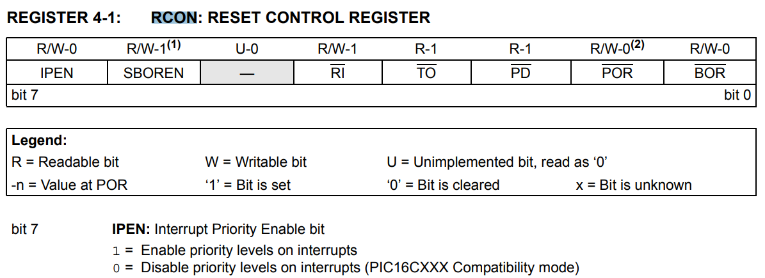
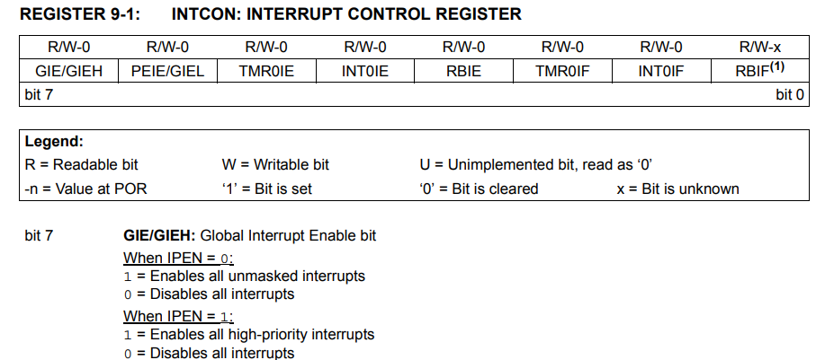
RCON:
INTCON:

Slide 10
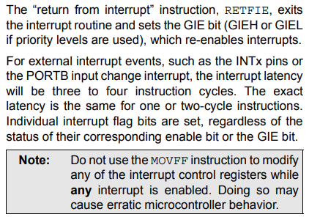
Notice !

Slide 11
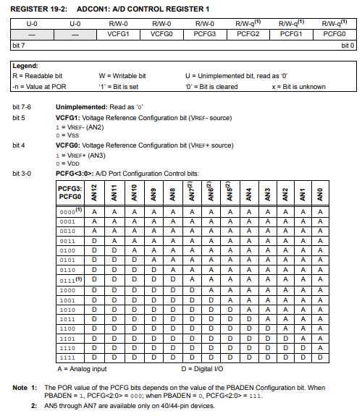
ADCON1

Slide 12
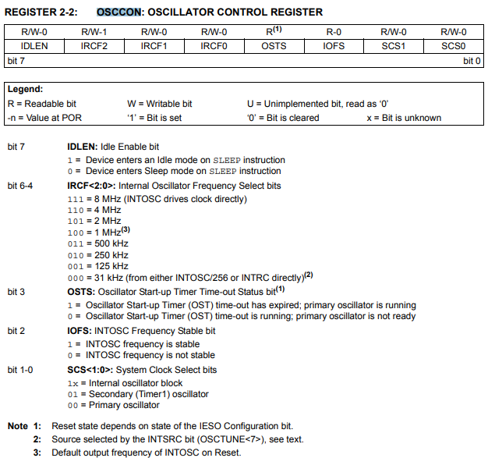
OSCCON

Slide 13
Reference
PIC18F4520 Datasheet: https://ww1.microchip.com/downloads/en/DeviceDoc/39631E.pdf

